Slide 1
Adding Up the Numbers A Statistical Visualization of the Linguistic Relationship Between Biblical Hebrew and Qumran Hebrew
Jarod Jacobs
Warner Pacific College

Slide 2
Summary
Research Question: In what ways are Qumran Hebrew and Biblical Hebrew related?
Design of project
Linguistic profile of “core” biblical texts, and 1QS and 1QM
Examination of all biblical texts and 1QS and 1QM
Conclusions

Slide 3
Research question
In what ways are Qumran Hebrew and Biblical Hebrew related?
Compare linguistic profiles
Consider possible diachronic explanation for differences
Analyze specific linguistic features

Slide 4
Design of Project
Corpora
Database
Analysis tools

Slide 5
Corpora
Biblical Hebrew
Hebrew Bible
Qumran Hebrew
The War Scroll (1QM) and The Community Rule (1QS)

Slide 6
Database
The Eep Talstra Centre for Bible and Computer (ETCBC) Syntactic Database
Developed at the Vrije Universiteit Amsterdam
Includes the Hebrew Bible, 1QS, 1QM, and some inscriptions
Contains linguistic information encoded hierarchically at the word, phrase, clause, and text levels
Notes:
Discuss advantages and disadvantages of this database

Slide 7



Analysis Tools
Python – programming language
Jupyter – Software for interactive computing across programming languages
R – Software environment for statistical computing and graphics

Slide 8
Analysis Tools
Statistical Analysis
Hierarchical Clustering
Dendrograms
PAM
Hypothesis Testing and p-values

Slide 9

Analysis Tools
Github – Development platform for open source project management.
Store code for external review
Publish data
Collaborate with other researchers

Slide 10
Linguistic Profiles of “core” texts
“EBH”, “LBH”, “QH”: Based on 13 features:
אני/ אנכי interchange
Plene and defective spelling of לא/לוא
Direct object marker
Directive-he
Infinitive absolute
Word order (SV/VS)
ל/אל interchange
אל/עלinterchange
Infinitive plus ל
מלכות/ממלכה
ש/אשר
Vav plus imperfect
Vayyiqtol

Slide 11
Linguistic Profiles of “core” texts
“EBH”
1QM/S
“LBH”

Slide 12
Linguistic Profiles of “core” texts
1QM/S
“EBH”
“LBH”

Slide 13
Linguistic Profiles of “core” texts
Cluster Strength
average | single | complete | ward
0.59 | 0.50 | 0.69 | 0.77

Slide 14
Linguistic Profiles of “core” texts

Slide 15
Linguistic Profiles of “core” texts
“LBH”
“EBH”
1QM/S
Notes:
Another feature available with pam is a plot known as a silhouette plot. First, a measure is calculated for each observation to see how well it fits into the cluster that it's been assigned to. This is done by comparing how close the object is to other objects in its own cluster with how close it is to objects in other clusters. (A complete description can be found in the help page for silhouette.) Values near one mean that the observation is well placed in its cluster; values near 0 mean that it's likely that an observation might really belong in some other cluster. Within each cluster, the value for this measure is displayed from smallest to largest. If the silhouette plot shows values close to one for each observation, the fit was good; if there are many observations closer to zero, it's an indication that the fit was not good. The sihouette plot is very useful in locating groups in a cluster analysis that may not be doing a good job; in turn this information can be used to help select the proper number of clusters. For the current example, here's the silhouette plot for the three cluster pam solution, produced by the command

Slide 16
Linguistic Profiles of “core” texts

Slide 17
Linguistic Profiles of “core” texts - conclusion
The core “EBH”, “LBH”, and Qumran texts group into clusters (with Ecclesiastes as an outlier)
These three clusters each have their own distinct linguistic profile
Esther appears to have a mixed linguistic profile, fitting most closely with “EBH”, but also sharing similarities with “LBH”

Slide 18
Linguistic Profiles of “core” texts – distinctive characteristics
“EBH” uses “early” features
“LBH” uses “late” features
“Qumran” uses “late” features, sometimes at the highest rate
 | 1cs | hl | infa
"EBH" | 0.57 | 0.0031 | 0.0021
"LBH" | 0.96 | 0.00075 | 0.00075
"Qumran" | 0.80 | 0 | 0.00033
Ecclesiastes | 1 | 0.00095 | 0.0050

Slide 19
Using Linguistic Profile of Core Texts to Linguistically Date biblical Texts Is it Possible?
The Core Texts’ clustering supports the traditional view of the diachronic development of Hebrew
Is it possible to then take the next step of linguistically dating other biblical texts?

Slide 20
Using Linguistic Profile of Core Texts to Linguistically Date biblical Texts Is it Possible? – Song of Songs
“EBH”
1QM/S
“LBH”

Slide 21
Using Linguistic Profile of Core Texts to Linguistically Date biblical Texts Is it Possible? – Zechariah
“EBH”
1QM/S
“LBH”

Slide 22
Using Linguistic Profile of Core Texts to Linguistically Date biblical Texts Is it Possible? – Hosea
“EBH”
1QM/S
“LBH”

Slide 23
Using Linguistic Profile of Core Texts to Linguistically Date biblical Texts Is it Possible? – Ruth
“EBH”
1QM/S
“LBH”

Slide 24
Analysis of all biblical texts, and 1QS and 1QM
Dividing Texts into Segments
“EBH”
1QM/S
“LBH”

Slide 25
Analysis of all biblical texts, and 1QS and 1QM
Do these texts group along diachronic lines?
“EBH”
1QM/S
“LBH”
Notes:
Pre – cluster contains five post and two exilic texts. Post cluster contains two preexilic texts

Slide 26
Analysis of all biblical texts, and 1QS and 1QM
Dividing Texts into Segments
1QM/S
“EBH”
“LBH”

Slide 27
Distinctiveness of 1QS and 1QM
Very similar to one another, while being distinct from “EBH”, “LBH”, and Ecclesiastes
High use of אני
Plene לוא
Low rate of direct object marker
No directive-hes
Low rate of infinitives absolute
High rate of על instead of אל
High rate of ל plus infinitive
Low rate of ל instead of אל
No occurrences of מלכות
No occurrences of שׁ–
Low rate of preterite
High rate of vav plus imperfect
Mixed word order
% of אני out of all 1cs pronouns
% of אל out of all occurrences of אל + על
Number of vayyiqotl per word
% of main clauses with SV word order
 | 1cs | ל(ו)א | dom | hl | infa | אל/על | linf | lal | מלכות | אשר/ש | vavc | vimp | wo
1QM | 61% | 0 | 0.0058 | 0 | 0 | 17% | 0.019 | 0.048 | 0 | 1 | 0.0003 | 0.0033 | 55%
1QS | 100% | 0 | 0.0062 | 0 | 0.0006 | 9% | 0.027 | 0.013 | 0 | 1 | 0.0003 | 0.0039 | 39%
 | 1cs | ל(ו)א | dom | hl | infa | אל/על | linf | lal | מלכות | אשר/ש | vavc | vimp | wo
"EBH" | 56% | 0.99 | 0.033 | 0.003 | 0.002 | 53% | 0.01 | 0.25 | 0 | 1 | 0.039 | 0.002 | 32%
"LBH" | 96% | 0.98 | 0.011 | 0.0007 | 0.0007 | 26% | 0.01 | 0.08 | 0.24 | 0.99 | 0.025 | 0.001 | 56%
"Qumran" | 81% | 0 | 0.006 | 0 | 0.0003 | 13% | 0.02 | 0.03 | 0 | 1 | 0.0003 | 0.003 | 47%
Ecclesiastes | 100% | 0.98 | 0.017 | 0.0009 | 0.005 | 38% | 0.02 | 0.09 | 0 | 0.56 | 0.0007 | 0.003 | 51%

Slide 28
Conclusions
The grouping of the “core” texts aligns with the traditional view of the typological classification of these texts
Full analysis reveals a complicated picture that does not seem to support the traditional approach to linguistically dating texts
Qumran texts (1QM and 1QS) are linguistically distinct from biblical texts

Slide 29
Next Steps
Expand features and texts analyzed:
מלכות – add all abstract nouns suffixed with ות
Refine direct object marker data
Movement away from Qal to Piel
Loan words
The object clause – word order and כי/אשר
30 total would be ideal – suggestions?
Include more Qumran texts
Notes:
dejoodejohan@hotmail.com Johan de Joode

Slide 30
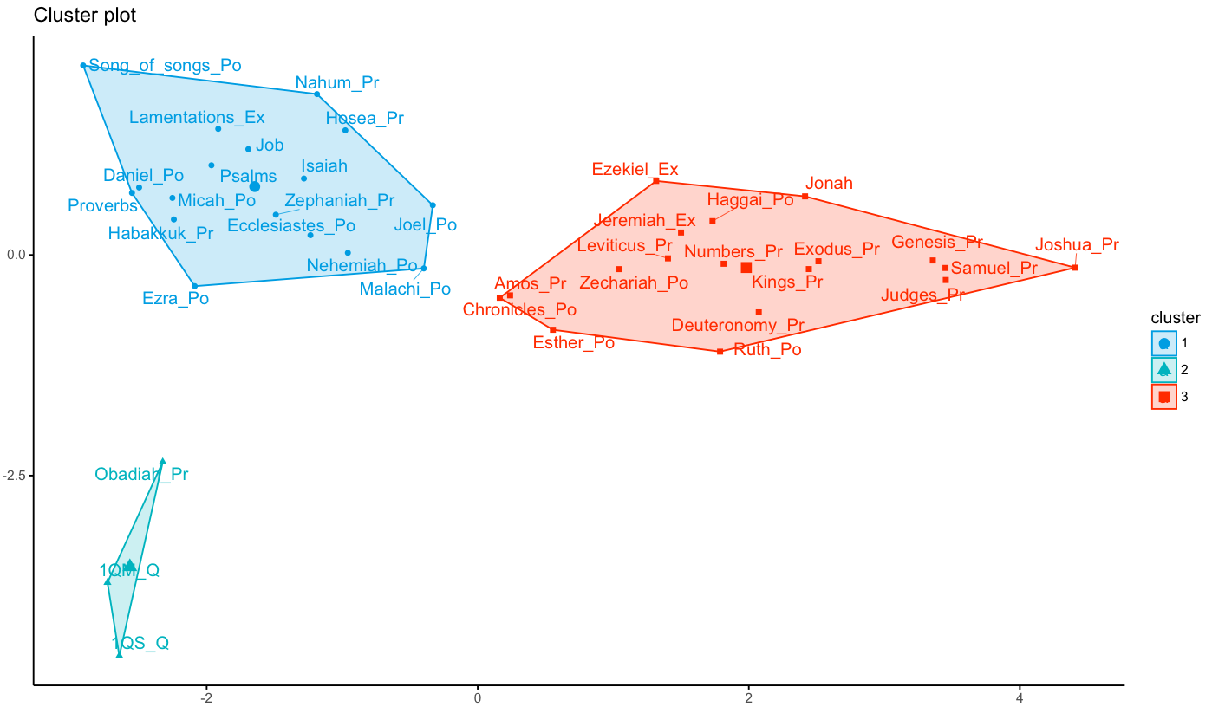
Analysis of all biblical texts, and 1QS and 1QM
Do these texts group along diachronic lines?
“EBH”
1QM/S
“LBH”
Notes:
Pre – cluster contains five post and two exilic texts. Post cluster contains two preexilic texts

